Slide 1

Done By:Dina Abuqare ,Mark Qarra ,Bashir Rimawi
Case Study: “DemoBlaze.com” E-Commerce Application

Slide 2
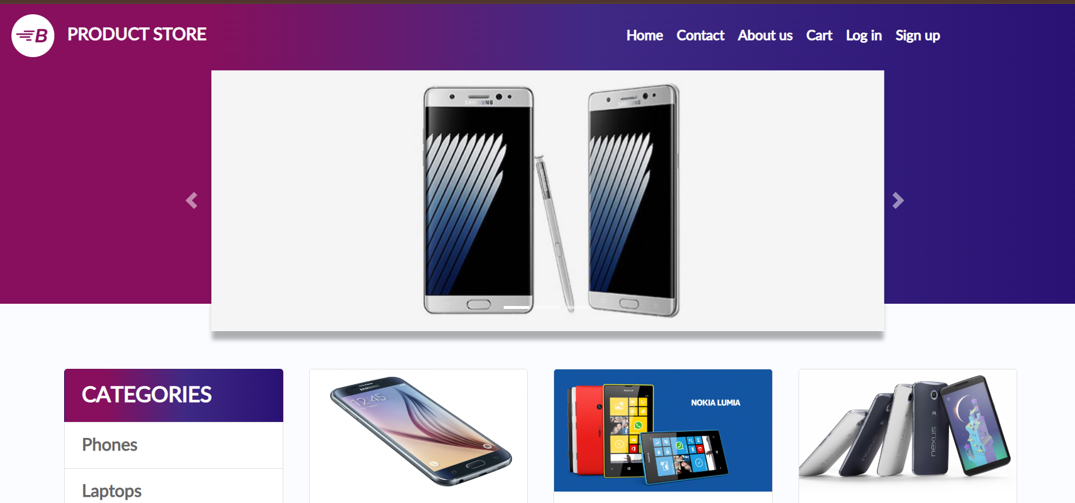
Introduction
This presentation outlines a structured QA testing approach for DemoBlaze.com,
an e-commerce website tested during our Automation Testing Project
It demonstrates how we applied concepts of test planning, workflow analysis, and SRS validation.
Dina

Slide 3
Project Overview & Scope of Testing
Project: Automation testing for DemoBlaze.com, an e-commerce site
Scope: Covers end-to-end workflows including login, product browsing, cart, and checkout,logout.
Objective: Ensure the application functions correctly for both normal and edge-case user interactions.
Bashir

Slide 4
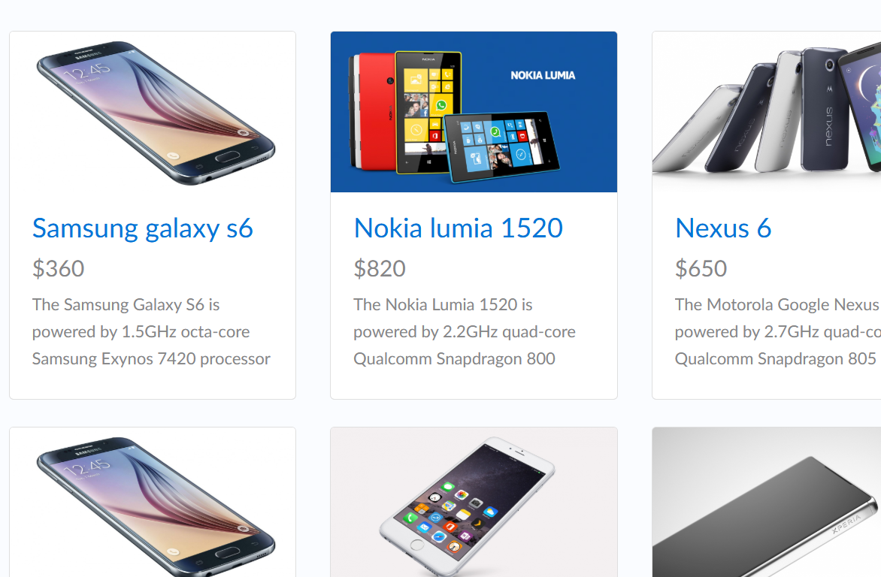
Application Overview
DemoBlaze.com is an online electronics store.
Users can register, log in, search and browse products, add them to a cart, and purchase them online.
The application includes essential e-commerce functionalities and basic admin features.
Mark

Slide 5

Test Approach
🔹 Manual Testing: Primary method for UI and functional test cases
🔹 Automation Testing: Selenium used to automate repetitive tasks
🔹 Test Scenarios Designed Based on: SRS Document, Workflows, and Expected User Behavior
Mark

Slide 6
User Interaction Workflows
1. User Registration and Login - credential validation
2. Product Selection - by category
3. Cart Operations - add, view, delete items
4. Purchase Process - shipping, payment, and order confirmation
5. User Logout - session termination and redirection
Bashir

Slide 7
Business Requirements Derived from SRS
✔ User must register/login to use cart and purchase
✔ Products should be selectable
✔ Shopping cart must maintain user selections
✔ Payment process must be secure and reliable
✔ System must support responsive design
Dina

Slide 8

Test Environment and Tools
Browser: Chrome, Edge (Windows 11)
Internet: Wi-Fi
Trello: Task and project tracking
Selenium with Java: Automation
TestNG: Execution framework
Microsoft Excel/Word: Test data and documentation
Bashir

Slide 9
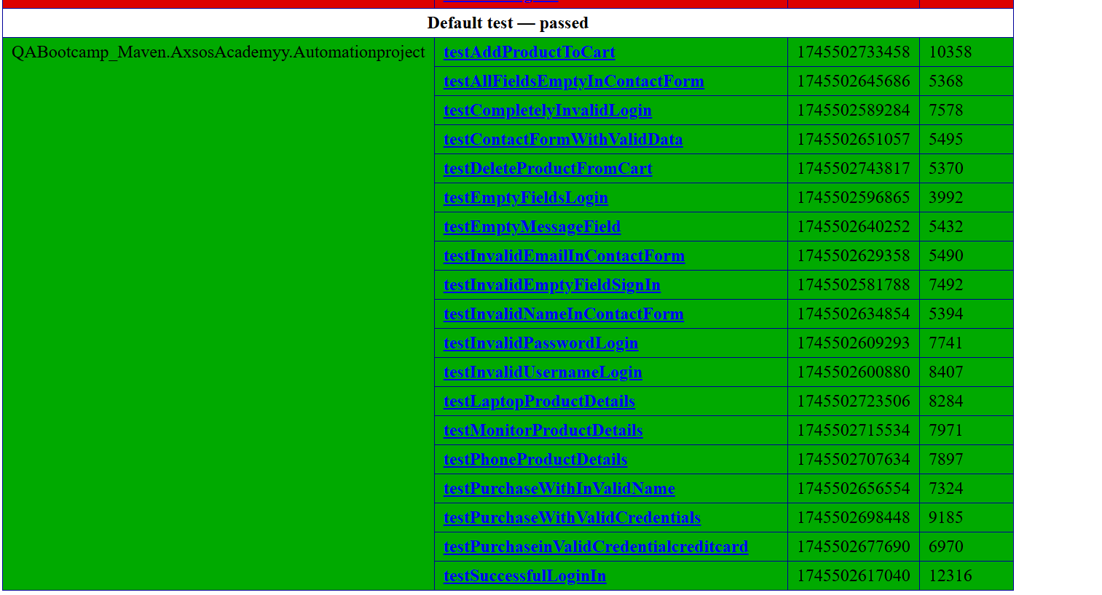
Test Reports: emailable.xml
Passed Test Cases:
Dina

Slide 10
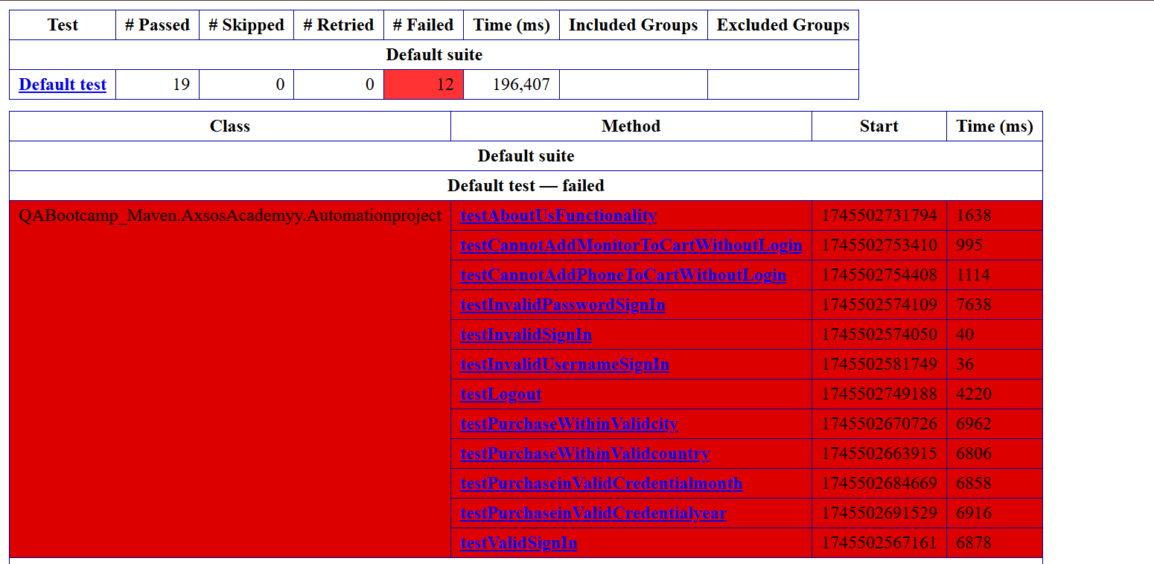
Test Reports: emailable.xml
Failed Test Cases:
Dina

Slide 11
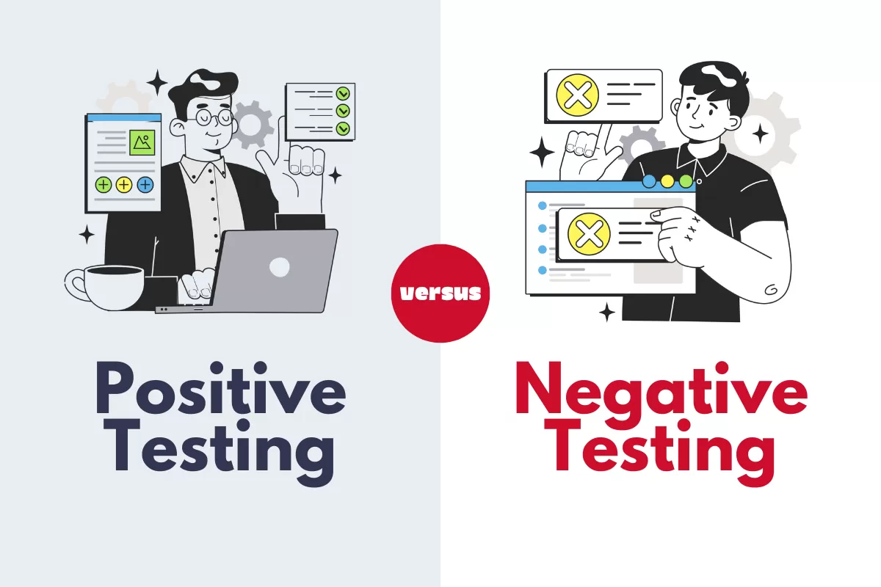
Test Summary
33 test cases were designed
Scenarios include: Positive, Negative, Boundary, and Edge Cases
Test coverage ensured all major workflows were verified
Testing aligned with SRS and business needs
Dina

Slide 12
🔸 Challenge: Keeping track of test case progress.
🔸 Solution: Trello board for collaboration and status tracking.
🔸 Challenge: Tools like Selenium, TestNG, e can seem confusing as startups.
✅ Solution: Practice automating and group working
Bashir

Slide 13
Conclusion
This project provided real-world experience in planning, designing, and executing QA tests.
We implemented a structured testing process aligned with industry practices.
Team collaboration, effective use of tools, and hands-on testing helped us ensure the reliability of DemoBlaze.com.
Mark

